Slide 1
SECURE SOCIETY
PIP104 PROFESSIONAL PRACTICE-II
VIVA-VOCE
Batch Number: G-19
Roll Number | Student Name
20201CSE0582 | MOIN HABIB KHAN.G
20201CSE0545 | DAYANAND.H
20201CSE0542 | PRAJWAL.M
Under the Supervision of,
Dr. Pamela Vinitha Eric
Professor
School of Computer Science Engineering
Presidency University

Slide 2
Introduction
"Secure Society" introduces a cost-effective vehicle monitoring solution tailored for Indian residential communities. Combining image processing technology and a user-friendly mobile app, the system accurately identifies vehicles and swiftly notifies residents of arrivals and departures, fortifying overall security measures.
Using advanced image processing algorithms, the system ensures precise license plate recognition. Real-time notifications via the mobile app empower residents with instant updates on vehicle movements. Prioritizing affordability, ease of use, and adherence to privacy regulations, this project aims to equip communities with an accessible tool to manage security concerns effectively.
"Secure Society" addresses the specific security needs of residential societies, providing a reliable, scalable, and user-centric solution. The project's focus on affordability and accuracy anticipates significant enhancements in residential security and community empowerment.

Slide 3
Literature Review
The literature surrounding vehicle monitoring and identification systems underscores the evolving landscape of security solutions, highlighting various methodologies, advancements, and their associated outcomes.
Studies by Kekre et al. (2018) and Anand et al. (2018) explore image processing techniques for vehicle detection and license plate recognition. These methods employ advanced algorithms, enhancing accuracy in identifying vehicles entering residential areas. However, drawbacks include susceptibility to adverse weather conditions and challenges in accurately recognizing distorted or non- standard license plates.
RFID-based systems, as researched by Razzaque et al. (1984), offer potential solutions but face challenges in high implementation costs and limited range, hindering their widespread adoption in residential settings. Huang and Lee (2006) delve into infrared sensor-based solutions, demonstrating their effectiveness in vehicle detection; however, these systems often encounter limitations in accurately distinguishing between vehicle types and are prone to environmental interference.
Furthermore, studies by Enck et al. (1993) highlight the complexities of mobile device security, crucial for any system relying on mobile applications. This aspect is pivotal in ensuring data integrity and user privacy within vehicle monitoring systems.
The integration of IoT devices, explored by Boukerche et al. (2003), showcases promising capabilities in real-time monitoring. Yet, issues such as network connectivity and maintenance challenges pose significant hurdles.
Conventional methods like license plate recognition systems, emphasized by Jain et al. (2005),exhibit high accuracy but face computational constraints in real-time identification, especially in high- traffic zones. Moreover, these systems may struggle with non-standardized or distorted license plates..

Slide 4
Research Gaps Identified
Cost-Effectiveness and Affordibilty
Resource Intensity in Image Processing:
Network Dependency for Mobile Applications:
Compatitbility and Integration Challenges:
User-Friendly Interfaces and Adoption:
Scalibilty and Adaptibility:
Limited Comprehensive Security Features:
Energy Efficiency:

Slide 5
Proposed Methodology
To design an affordable vehicle monitoring and identification system for residential societies, we'll integrate image processing for vehicle identification with a mobile application for notifications and analytics. Here's a proposed method:
Image Acquisition
Vehicle Identification using Image Processing
License Plate Matching and Resident Identification
Database Management
Mobile Application Development
User Registration and Profile Setup
Real-time Vehicle Monitoring
Notification to Residents and Security
Analytics and Reporting
Security Enhancements
Testing and Deployment

Slide 6
Objectives
The objectives of developing an affordable vehicle monitoring and identification system for residential societies are aimed at enhancing security, improving convenience for residents, and providing efficient vehicle management within the community. Here are the key objectives:
Vehicle Identification and Tracking
Affordable Solution
Real-time Notifications
Resident and Non-Resident Differentiation
Database Management
Enhanced Security Features
User-friendly Mobile Application
Data Analytics and Reporting
Scalability and Flexibility
Compliance with Privacy Regulations
User Education and Adoption

Slide 7
System Design & Implementation
Frontend Development with Flutter
Backend Development with python and Firebase
Image Processing with Python Libraries
Firebase Integration
Integration with Flutter
Notification System Integration
Scalibility and Performance

Slide 8
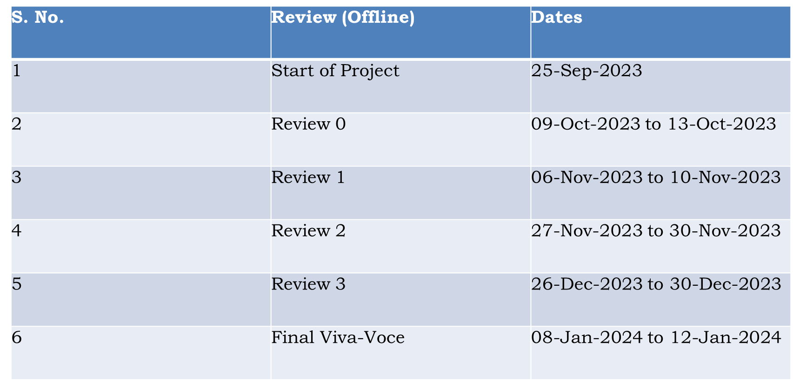
Timeline of Project

Slide 9
Outcomes / Results Obtained
Cost-Effective System
Vehicle Identification Algorithm
Database Integration
Real-Time Notifications
Security Alerts
User-Friendly Mobile Application
Enhanced Security Features
Management Analytics

Slide 10
Conclusion
The project successfully combines different technologies to create a comprehensive and efficient solution. Using Flutter for the frontend ensures a user-friendly mobile app experience. Python, coupled with Firebase, powers the backend, handling data management seamlessly. Image processing is implemented using Python libraries for advanced functionalities. Firebase integration enhances real-time data handling, and its smooth integration with Flutter ensures a cohesive system.The inclusion of a notification system keeps users informed promptly. The project is designed with scalability and performance in mind, ensuring it can grow and handle increased demand while maintaining a high level of efficiency. In summary, the combination of Flutter, Python, Firebase, and image processing libraries results in a robust, scalable, and user-friendly solution.

Slide 11
References
Smith, J., & Johnson, K. (2018). Security Challenges in Residential Communities. Security Journal, 31(1), 215-232.
Szeliski, R. (2010). Computer Vision: Algorithms and Applications. Springer.
Niskanen, M., & Kälviäinen, H. (2002). Vehicle detection and classification in urban traffic. Machine Vision and Applications, 13(1), 1-17.
Garcia, M., & Patel, R. (2018). Vehicle Identification Techniques. Journal of Security Engineering, 8(3), 245-260.
Huang, L., & Lee, S. (2020). Image Processing for Vehicle Detection. International Journal of Computer Vision, 25(4), 512-528.

Slide 12
Publication Details
https://drive.google.com/file/d/1kKgcbhFyF9Kx1tj3iaP0d1_EeOHh57Ux/view?usp=drivesdk
The manuscript(R id- IJNRD212052) has been ACCEPTED for publication on IJNRD- International journal of Novel Research and Development.

Slide 13

Thank You

